Slide 1
Microsoft coco: Common objects in context
Group: 4B
Protiva Das 24166051
CSE707

Slide 2
Abstract
The authors introduced a new dataset designed to enhance object recognition by integrating it into comprehensive scene understanding. The dataset includes images of everyday scenes with common objects in their usual environments, marked with per-instance segmentations for accurate identification. It comprises 328,000 images with 2.5 million labeled instances of 91 object types recognizable by a young child. The dataset was compiled with the help of crowd-sourced workers using innovative interfaces for categorizing and segmenting objects. We compare our dataset statistically with existing ones like PASCAL, ImageNet, and SUN, and evaluate its performance using Deformable Parts Model for object detection and segmentation.

Slide 3
Introduction
The work emphasizes on essential elements of scene understanding, such as recognizing objects from various angles, understanding their attributes and relationships, and semantically describing the scene.
It discusses the shortcomings of current datasets in achieving deep scene understanding, specifically their focus on iconic views of objects, which doesn't reflect the complexity of real-world scenes.
A new large-scale dataset is introduced, designed to address the specific needs for advanced scene understanding. This dataset emphasizes non-iconic views of objects, contextual relationships between objects, and precise 2D localization.
The process of creating the dataset is outlined, detailing the use of Amazon Mechanical Turk to collect and label images that include complex scenes with multiple object interactions and varied object presentations.
The new dataset, named MS COCO, is described in terms of its size and scope, including statistics like the number of images and instances per category.

Slide 4
Related Works
Deep learning has significantly improved medical image analysis, though challenges remain in data sharing and annotation; future focus could be on unsupervised learning and enhancing dataset annotations [1]
Models that simulate [2] brain functions have achieved significant advances in speech and visual recognition using deep learning, yet they encounter challenges with large dataset management and computational constraints.
ImageNet has effectively enhanced object recognition through its large, structured database, yet there is still a need to expand this dataset to further improve model training in[3].

Slide 5
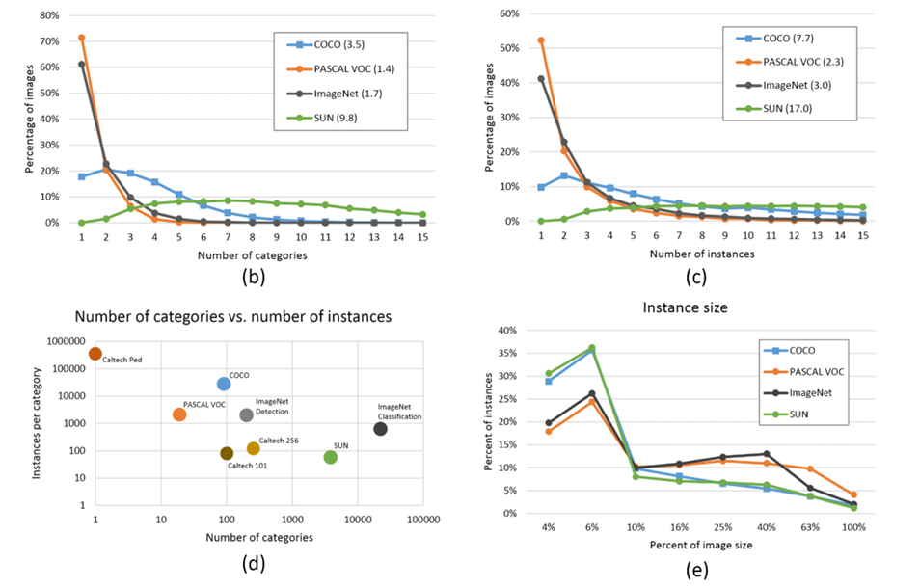
Methodology
Dataset:
Datasets were used the Microsoft COCO dataset, specifically created for advancing object recognition and scene understanding research.
Data Analysis:
The authors analyzed the Microsoft COCO dataset containing over 328,000 images and 2.5 million labeled instances across 91 different object types. The dataset includes detailed instance-level segmentation to improve precision in object localization and scene understanding.

Slide 6
Result Analysis
The Microsoft COCO dataset includes 328,000 images with 2.5 million labeled instances spanning 91 diverse object types, significantly enhancing dataset diversity for object recognition tasks.
Emphasizing everyday scenes and non-iconic views, the dataset trains models to recognize objects in complex environments, improving adaptability and real-world applicability.
With instance-level segmentation provided for each object, the dataset facilitates precise object localization and detailed scene analysis, crucial for advanced computer vision applications.
Microsoft COCO offers an average of 7.7 object instances per image, compared to lower densities in other datasets like ImageNet (3.0) and PASCAL VOC (2.3), enriching context learning in model training.

Slide 7
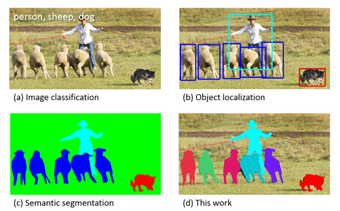

Slide 8
Referencing
H. Guan and M. Liu, “Domain adaptation for medical image analysis: A survey,” IEEE Transactions on Biomedical Engineering, vol. 69, no. 3, pp. 1173–1185, 202
G. Litjens, T. Kooi, B. E. Bejnordi, A. A. A. Setio, F. Ciompi, M. Ghafoorian, J. A. Van Der Laak, B. Van Ginneken, and C. I. S´ anchez, “A survey on deep learning in medical image analysis,” Medical Image Analysis, vol. 42, pp. 60–88, 2017.
Y. LeCun, Y. Bengio, and G. Hinton, “Deep learning,” Nature, vol. 521, no. 7553, pp. 436–444, 2015.
J. Deng, W. Dong, R. Socher, L.-J. Li, K. Li, and L. Fei-Fei, “Imagenet: A large-scale hierarchical image database,” in 2009 IEEE Conference on Computer Vision and Pattern Recognition. IEEE, 2009, pp. 248 255.

Slide 9
Thank You
Any Questions Or Suggestions?

